Slide 1
Performance, Quality & Improvement
Quarterly Report – Q3 2022
July-Sept

Slide 2
INTRODUCTION
Welcome to our Performance, Quality & Improvement (PQI) Quarterly Report! This report is for all stakeholders, including clients, staff, community members, board members, funders, and any individual who is interested in the great work we do. PQI is an integral part of our organization. We are always open to new opportunities to change, grow and improve.
We hope this report demonstrates our commitment to making a positive impact in the lives of the children and families we serve, our commitment to constantly working to operate more effectively, and our transparency to our stakeholders. If you have ideas on how this document can be improved, please let us know!

Slide 3
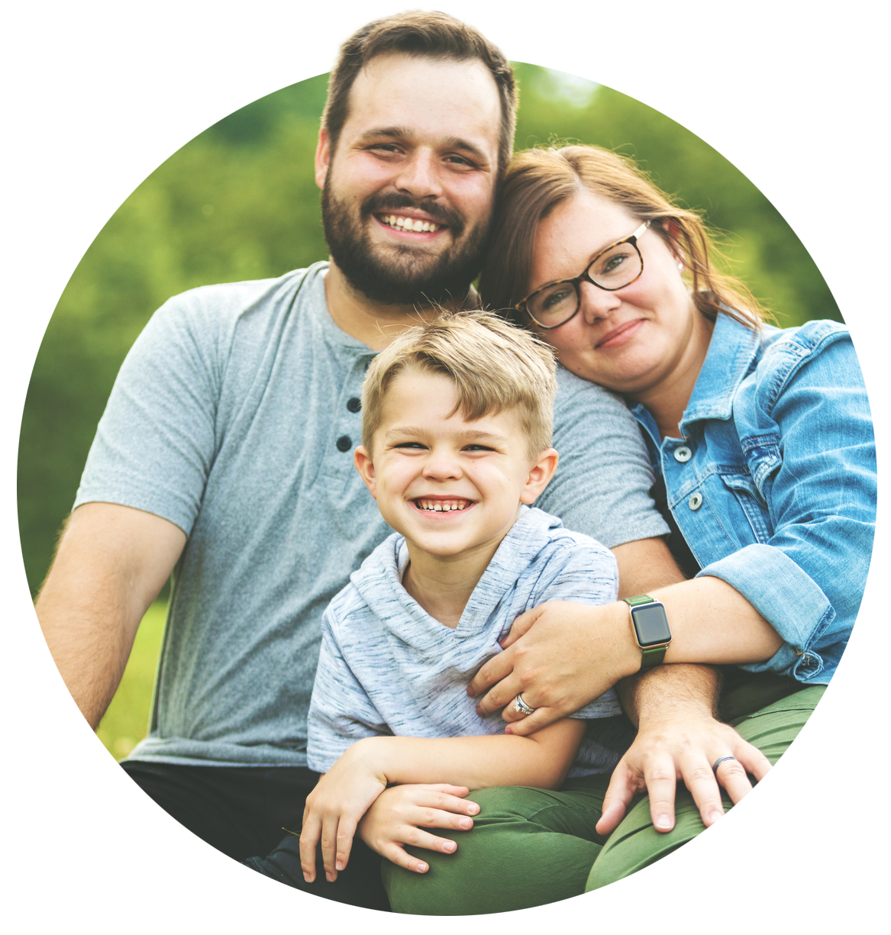
MISSION STATEMENT
To provide foster and adoptive children a stable, loving and nurturing family environment by support and advocacy for abused and neglected children and the families caring for them.

Slide 4
CORE BELIEFS
All children deserve to be valued, nurtured and provided with the opportunity to be the best that they can be.
Families are the key to successfully impacting children in child welfare. Everyone else on the team: social workers, therapists, attorneys, medical providers, judges…. are less important than the family in terms of making a difference for the child.
All families are valuable, no matter how dysfunctional, to the members of that family.
People almost always do the very best that they can in the moment. Often, when they know better, they can do better.
Commitment is the most important competency for foster, adoptive, kinship and relative families.
If it is the right thing for a child, there is probably a way to make it happen.

Slide 5
CORE VALUES

Slide 6
ORGANIZATIONAL IMPACT
Section 2

Slide 7
BEHAVIORAL INTERVENTIONIST
The BI program provides intensive one-on-one services within the family home to children who struggle with behavioral and emotional management to the degree that the behaviors threaten the stability of their current placement. Direct care staff use role-modeling, coaching, re-direction, to develop self-regulation, de-escalation techniques, and developing independence in daily living activities.

Slide 8
BEHAVIORAL INTERVENTIONIST PROGRAM – Q3 2022
80 youth served this quarter
8,703 BI hours provided this quarter
88% of youth served avoided residential treatment and/or hospital admissions this quarter
99% of youth served avoided placement disruption due to behavioral concerns this quarter

Slide 9
COMMUNITY CONNECTIONS YOUTH PROJECT
Community Connections Youth Project helps connect youth to resources in several areas including housing, higher education, employment, healthcare, finances, social supports, transportation, legal advocacy, and more. The goal of this program is to help young adults find stable housing, secure employment, and develop the necessary skills to thrive in adulthood.

Slide 10
COMMUNITY CONNECTIONS YOUTH PROJECT – Q3 2022
94 youth served through the CCYP program
45 clients obtained part-time or full-time employment
34 clients received financial education on monthly budgeting
41 clients were assisted with emergency funds to prevent crisis (i.e., paying utility or medical bills, etc.)
13 clients were assisted with housing funds to prevent crisis (i.e., paying off past evictions, rent to avoid evection, etc.)
$6,872.55 were allocated to serve these young adults to aid them in their successful transition into adulthood.*
*Resource Allocation: Donations received from community to FosterAdopt Connect to assist in securing permanent, safe housing including furniture, bedding, household items, kitchen/cooking items, etc.

Slide 11
FAMILY ADVOCACY
The advocacy program assists foster/adoptive parents to navigate the complex issues within child welfare when they experience problems or barriers. The advocate staff are experienced foster parents themselves who can help address specific concerns and quickly implement action plans.

Slide 12
FAMILY ADVOCACY PROGRAM – Q3 2022
75% of clients reported the service provided reduced their stress level
314 clients served (203 families)

Slide 13
KINSHIP NAVIGATOR
The overall goal of Kinship Navigator is to build and/or enhance protective factors for kinship families that are not actively involved in the child welfare system, but are caring for relative children and youth at risk of entering or reentering foster care. The program helps reduce or eliminate barriers for access to needed services and supports so children can be safely maintained in their homes to reduce the likelihood of placement disruption and child welfare involvement.

Slide 14
KINSHIP NAVIGATOR PROGRAM – Q3 2022
382 relative caregivers and the children they care for were served through the Kinship Navigator Program.
97% of Kinship Caregivers who completed the program in the past quarter improved their ability to meet the basic needs to safely care for the children in their home, as measured by a reduction in Family Needs Scale Assessment score.

Slide 15
FOSTERING PREVENTION
The mission of Fostering Prevention is to strengthen parents’ capacity to provide safe, permanent, and nurturing homes for their children. The program provides evidence-based parenting curriculum, resource identification and connection, support, and advocacy to families who are coping with significant hardships. The goal of Fostering Prevention is to prevent children from unnecessarily entering foster care.

Slide 16
FOSTERING PREVENTION PROGRAM – Q3 2022
99% of children living with the Fostering Prevention parent maintained placement stability this quarter.
56 caregivers served
113 children served

Slide 17
LICENSING
This program works directly with families to complete the requirements of licensure for pursuing fostering and adopting children from the child welfare system in Missouri. After licensing approval, staff continue to assist families as they begin the fostering process by providing advocacy, support, resources, and ongoing training.

Slide 18
LICENSING PROGRAM – Q3 2022
21 households licensed
20 adoptions finalized
73 referrals in process
321 licensed homes

Slide 19
PARENT TRAINING
Parent training classes that help foster parents earn credits to maintain foster home licensure in Missouri. We offer a variety of in-person and virtual training options for families.

Slide 20
PARENT TRAINING – Q3 2022
295 participants trained this quarter
181 brand-new training participants this quarter
294 training hours provided this quarter

Slide 21
EXTREME FAMILY FINDING
This program puts a team of recruiters and private investigators to work finding multiple extended family members and kin relationships for children most at-risk of aging out of foster care without an adoptive resource, such as older youth, large sibling groups, and children with significant medical or mental health issues.

Slide 22
EXTREME FAMILY FINDING PROGRAM – Q3 2022
59 children served this quarter. Of those children with closed cases:
80% reconnected with family and friends they lost touch with throughout their time in foster care
80% matched with families for purposes of adoption or guardianship.
3 finalized their adoption or guardianship.

Slide 23
30 DAYS TO FAMILY
This program provides an intense, short-term intervention designed to increase the number of children placed with family or friends within the first 30 days of children entering foster care.

Slide 24
30 DAYS TO FAMILY PROGRAM – Q3 2022
39 children served this quarter
63% of children served were placed with relatives/kin within 30 days of coming into foster care.
Long-term stability results (2017 to end of Q3 2022)
82% of children remained with relative/kinship placement

Slide 25
SAMMY'S WINDOW
A hybrid clothing closet and food pantry program, Sammy’s Window helps lift the financial burden of caring for foster and adopted children and enhances the capacity of regional foster homes to provide care to an increasing number of children in Missouri and Kansas.

Slide 26
SAMMY'S WINDOW – Q3 2022
1,628 caregivers and 3,326 children served across all branches this quarter
Estimated value of resources/goods given to families
Cape Girardeau: $24,643
Chillicothe: $7,534
Hannibal $527
Independence: $102,874
Joplin: $2,357
Kansas: $17.347
Kirksville: $3,849
Mountain Grove: $1,696
Poplar Bluff: $26,440
Springfield: $149,873

Slide 27
LEGAL ADVOCACY
FosterAdopt Connect’s legal advocacy team connects current or former foster youth with attorney representation to aid with minor legal issues, which then frequently become barriers to living a healthy and fulfilling life.

Slide 28
LEGAL ADVOCACY PROGRAM – Q3 2022
24 individuals served this quarter
26 court appearances this quarter

Slide 29
Adopt Kansas Kids is the Adoption Exchange for Kansas. The program raises awareness about the need for adoptive families for children who currently are in foster care as well as providing coaching and consultation to other child welfare professionals to better prepare children and families for adoption from foster care. Adopt Kansas Kids also supports families who are interested in becoming an adoptive parent for a child in foster care.
As people inquire about their interest in adopting, Adopt KS Kids will: 1) provide education about the adoption process; 2) answer all questions while trying to decide if adoption is their option; and 3) connect families to an agency in their state who is able to support them and prepare them for the next steps of adoption.

Slide 30
ADOPT KANSAS KIDS – Q3 2022
901 adoption inquiries
10 adoptions finalized
263 new families registered with Adopt Kansas Kids

Slide 31
KANSAS POST ADOPTION RESOURCE CENTER (K-PARC)
K-PARC is a program dedicated to strengthening kinship and adoptive families in Kansas through advocacy, peer to peer support groups and networking, as well as training opportunities.

Slide 32
KANSAS POST ADOPTION RESOURCE CENTER (K-PARC) – Q3 2022
30 families served
57 hours of direct client advocacy and support provided
1 Support Group offered
5 Training Courses offered

Slide 33
KANSAS CAREGIVERS SUPPORT NETWORK (KCSN)
KCSN provides meaningful representation and a voice to those providing care for children not born to them. KCSN works to provide for caregivers' needs in a variety of ways including peer to peer support and mentoring, education and training opportunities, and information and resources to assist all caregivers in feeling equipped to handle the needs of children in foster care.

Slide 34
KANSAS CAREGIVERS SUPPORT NETWORK (KCSN) – Q3 2022
12 families served
25 hours of direct client advocacy and support provided
2 Support Groups offered
15 Training Courses offered

Slide 35
MISSION MOMENT
Section 3

Slide 36
MISSION MOMENT – Q3 2022
In June 2022, Kansas Caregivers Support Network (KCSN) partnered with Adopt Kansas Kids, Sammy’s Window KS, and Cornerstones of Care to host a Reunification Celebration Event. Families served by Cornerstones of Care who had successfully reintegrated between January and June of 2022 were offered an opportunity to come to the FosterAdopt Connect Headquarters in Kansas City, KS to enjoy free snacks, a professional family photography session, and a free unlimited “shopping” spree in the Sammy’s Window clothing closet and food pantry. Each of the families left with a fresh supply of hygiene products, food, toys, and clothes. In addition, each family got to go home with a framed professional family portrait to commemorate their success.

Slide 37
STAFF RECOGNITION
Section 4

Slide 38
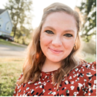
JULY EMPLOYEE OF THE MONTH
Brittany Brooks
Title: Assistant Director of Resource Development
Branch: HQ
Brittany started at FAC in August 2015 as an intern and began working full-time in the Licensing department in December 2015. Since being at FAC, she was promoted to Senior Resource Development Advocate in 2017 and will be taking over as the Assistant Director of Resource Development this month.
She has two daughters, Emma (age 4) and Livie (age 1) and will be getting married in September 2023 to her fiancée, Andrew.

Slide 39
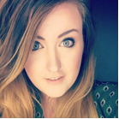
JULY EMPLOYEE OF THE MONTH
Jarah Green
Title: 30 Days to Family Specialist
Branch: Springfield
Jarah has been with FAC since June 2021. She has worked in the child welfare field for 12 years and greatly enjoys the family finding she is currently doing.
When not at work, Sarah loves going to see live music or visiting breweries with friends. Otherwise, she can be found at home reading and hanging out with her two kitties

Slide 40
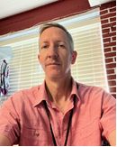
AUGUST EMPLOYEE OF THE MONTH
Steve Trenholm
Title: Direct Services Manager
Branch: Kansas City, Kansas
Steve moved to Kansas City in 1980 during one of the hottest heatwaves to hit the Midwest. He worked for Winstead's Restaurants as a general manager for eight years, followed by 19 years as Director of Mail Order Operations for Strawberry Hill Povitica Co.
Steve is currently the Director of the Asbury UMC Community Food Pantry (his church) and a volunteer for the CORE Unit at the Shawnee PD. He spends his spare time reading and enjoys staying active - hiking, kayaking and flying his friend’s plane whenever possible!

Slide 41
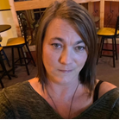
AUGUST EMPLOYEE OF THE MONTH
Jamie Niemeier
Title: Family Advocate/Trainer
Branch: Macon
Jamie has been with FAC since April 2022. She has a Bachelor's of Social Work from the University of Central Missouri. He is a foster parent and has four amazing kiddos who are 12, five, three, and two.
She enjoys spending time with her kids outside exploring, traveling, and spending time with friends.

Slide 42
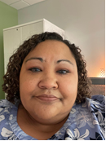
SEPTEMBER EMPLOYEE OF THE MONTH
Lisa Allen-Clay
Title: Behavioral Intervention Program Manager
Branch: Springfield
Lisa has been with FAC since April 1, 2020. She is currently working on her PhD in Human Services with a specialization in Prevention, Intervention, and Advocacy. Lisa is a mom to three boys who she fostered and then adopted. She loves traveling and has been to several European countries. She also enjoys singing and performed in several plays during her undergrad years.

Slide 43
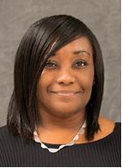
SEPTEMBER EMPLOYEE OF THE MONTH
Tysa Coleman
Title: Family Advocate
Branch: Hannibal
Tysa began working for FAC in Jan 2022. She has served in several social service positions, including Facilitator and Co-Facilitator of Independent Living, a program for children in foster care.
She has served as a Domestic and Sexual Violence Advocate, Victim Advocate (Prosecuting Attorney’s office), Family Advocate at a Child Advocacy Center, and Grant Writer/Administrator at the Child Advocacy Center. Tysa currently sits on the Board of Education for the Hannibal Public School District. She is also the Region Two Board Representative for the Missouri Balance of State Continuum of Care.
Tysa is the author of the book, "The Thoughts and Prayers of a Single Mother". Three of her kiddos are still at home, and the other two are adults finding their way in life. In her free time, whenever that is, she likes to write short stories and meet up with her friends for coffee.

Slide 44
CONTACT US
Section 5

Slide 45
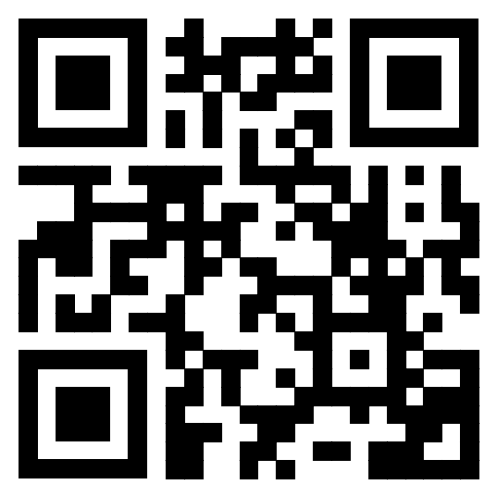
CONTACT US!
If you have any feedback about this report, please contact Meredith Greenfield via email at meredith.greenfield@fosteradopt.org.
If you are a current or past client, we always welcome your feedback via the Client Satisfaction Survey.
SCAN HERE

Slide 46
EVERYONE CAN DO SOMETHING FOR A CHILD IN NEED. Join us.

